Slide 1
High Speed ALU Processor by Using Fast Multiplication Technique
As the scale of integration keeps growing, more and more sophisticated and fast processing systems are being implemented on a VLSI chip. These fast processing system applications not only demand great computation capacity but also consume considerable amount of power. And the ALU is the main functional unit in most of digital and high performance systems such as FIR filters, digital signal processors and microprocessors etc. So the performance of such VLSI circuit is dependent on the performance of the ALU. The performance of ALU mainly depends on the performance of multiplier because the multiplier is generally the slowest and area consuming element in the system. Hence, optimizing the speed and area of the multiplier is a major design issue. Here, a High-speed multiplier is designed and analyzed which is based on the algorithm named as “Urdhva Tiryakbhyam” sutra (UT Technique). Traditionally, this well known Technique has been used for fast multiplication. The proposed algorithm is developed using VHDL

Slide 2
Introduction
An arithmetic logic unit (ALU) is a Computation unit that performs various arithmetic (addition, subtraction, multiplication) and logical operations (AND, OR, INVERTER). And that’s why the ALU is called heart of microprocessor, microcontroller and digital signal processor. The performance of Fast processing system is dependent on the speed of the ALU. The speed of ALU depends greatly on the multiplier. In algorithmic and structural levels, numerous multiplication techniques have been developed to enhance the efficiency of the multiplier which concentrates in reducing the partial products and the methods of their addition but the principle behind multiplication remains the same in all cases. Vedic Mathematics is the ancient system of mathematics which has a unique technique of calculations based on 16 Sutras. Employing these techniques in the computation algorithms of the coprocessor will reduce the complexity, execution time, area, power etc. Though there are many sutras employed to handle different sets of numeric, exploring each one gives new results. This project has proved the efficiency of Urdhva Tiryakbhyam- Vedic method for multiplication.

Slide 3
2. MULTIPLICATION TECHNIQUE
Urdhva Tiryakbhyam (UT) technique is sutra of Vedic mathematics used for multiplying two given numbers in Decimal number system. However, we put forward the multiplication of two binary numbers using this technique. The literal meaning of UT is “Vertically and crosswise” and the multiplication happens in this fashion. UT is a novel concept through which introduces a parallel execution of partial products and sums which is explained in fig- 1. The word Vedic is derived from the word ‘Veda’ which means the store-house of all knowledge. Hundred years ago(in between 1911 and 1918) Sanskrit scholars Jagadguru Swami Sri Bharati Krishna Tirthaji translated the Vedic documents and got surprised about the depth of knowledge enriched in that and became very popular to achieve high speed processing of the data.

Slide 4
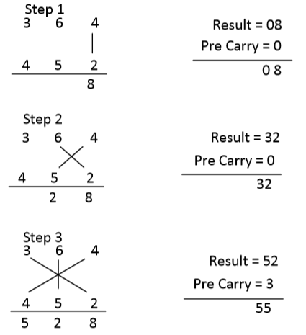
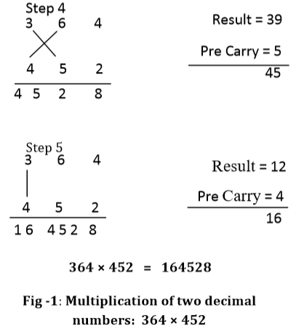

Slide 5
Vedic mathematics mainly based on 16 Sutras dealing with various branches of mathematics like arithmetic’s, algebra, geometry etc. these sutras with their brief meaning are given below.
(Anurupye) Shunyamanyat -If one is in ratio, the other is zero.
ChalanaKalanabyham -Differences and similarities.
Ekadhikina Purvena- By one more than the previous One.
Ekanyunena Purvena -By one less than the previous one.
Gunakasamuchyah-Factors of the sum is equal to the sum of factors.
Gunitasamuchyah-The product of sum is equal to sum of the product.
Nikhilam Navatashcaramam Dashatah -All from 9 and last from 10.
Paraavartya Yojayet-Transpose and adjust.
Puranapuranabyham -By the completion or noncompletion.
Sankalana- vyavakalanabhyam -By addition and by subtraction.

Slide 6
Shesanyankena Charamena- The remainders by the last digit.
Shunyam Saamyasamuccaye -When the sum is same then sum is zero.
Sopaantyadvayamantyam -The ultimate and twice the penultimate.
Urdhva-tiryakbhyam -Vertically and crosswise.
Vyashtisamanstih -Part and Whole.
Yaavadunam- Whatever the extent of its deficiency

Slide 7
3. Proposed Multiplier Architecture
UT Technique based Multiplier is efficient hardware architecture for multiplying two integers, compared to a normal multiplier; it is mostly used for high speed multiplication. The block diagram of 4×4 bit Multiplier is shown in Fig -2. The 4×4 bit Vedic Multiplication unit is further realized by incorporating four similar modules of 2×2 multipliers. The processing in the form of block diagram is depicted in Figure-2. Demonstrating with an example of two digits consisting of 4 bit each named as A=A3A2A1A0 and B=B3B2B1B0 the output is obtained in 8 bits length say P7-P0 and last two output bit P8, P9 are Garbage Bits. Furthermore, the numbers A and B is divided into two equal parts of two bits A[3:2], A[1:0] and B[3:2], B[1:0]. Now the 8 bit end product term is understood as:

Slide 8
P[1:0] = A[1:0]×B[1:0]
P[9:2] = A × B
P[9:2] = {(A[1:0]×B[1:0])+(A[3:2]×B[1:0])} + {(A[1:0]×B[3:2])+(A[3:2]×B[3:2])}
Multiplication of higher bits can be done in the similar manner. This multiplication technique is faster than any of the conventional multipliers. This technique uses less number of computational steps to get the result.

Slide 9
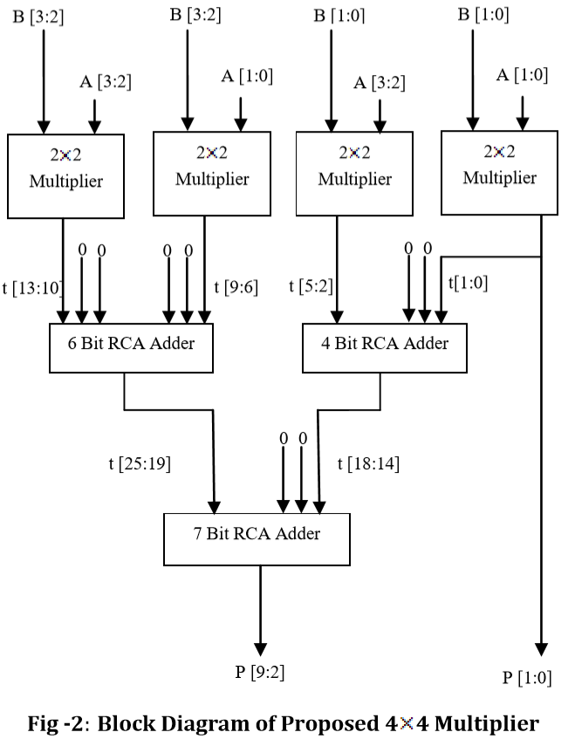

Slide 10
4. Results and discussions
Proposed Vedic multiplier is compared with Array and Vedic Multiplier in terms of area and delay. Results obtained from these implementations are shown in Table 2. Area is nothing but the Number of Used slices in the design and delay is maximum combinational path delay obtained from the final report. Proposed Vedic multiplier shows better performance results than Array and Vedic Multiplier in terms of area as well as delay as shown in fig. 4. Proposed Vedic multiplier is faster compared to Array and Vedic Multiplier. By using of proposed Vedic multiplier construct an ALU Architecture that shows the computational benefits given by UT Technique.

Slide 11
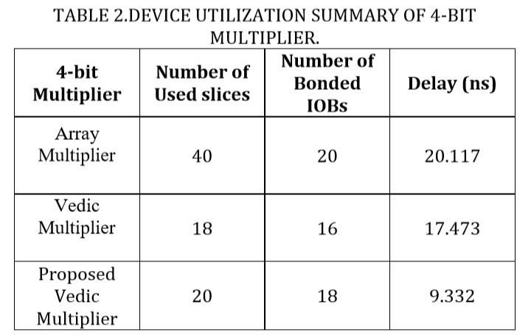

Slide 12
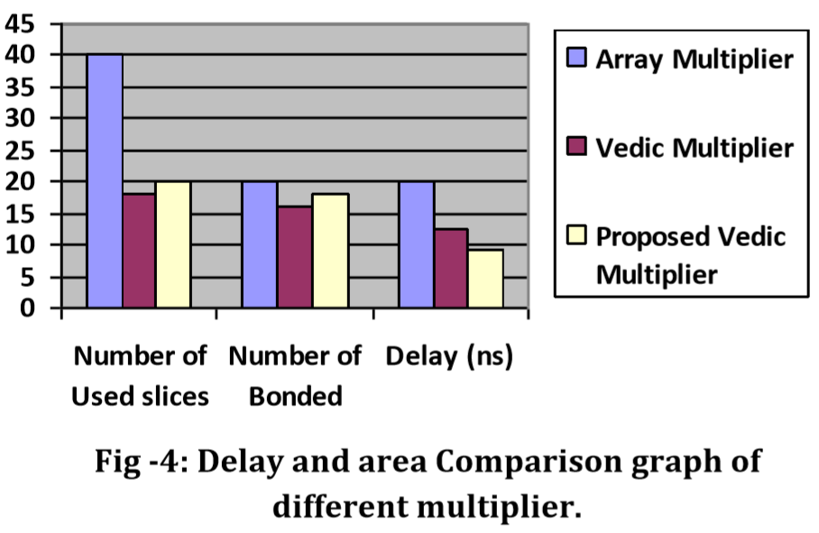

Slide 13
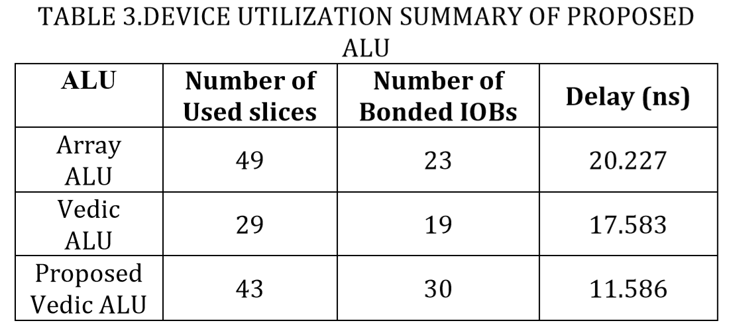

Slide 14
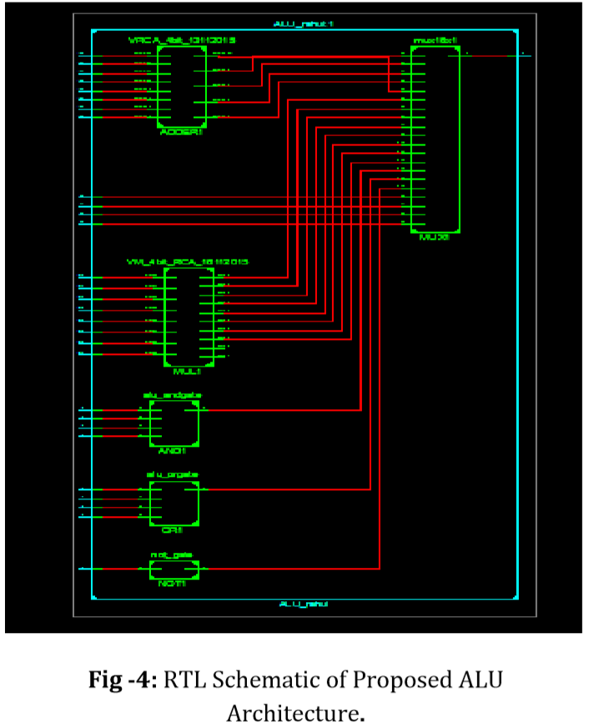

Slide 15
5. CONCLUSIONS
In this project we have proposed an extremely effective method of multiplication based on Urdhva- Tiryakbhyam algorithm. With this method we can construct multiplier and practically saw that Proposed Vedic Multiplier is much more efficient than Array and Vedic multiplier as shown in the Table2. By using of proposed multiplier construct an ALU Architecture that shows the computational benefits given by UT Technique. Since our objective was to reduce the computational path delay for proposed ALU is found to be 11.586ns, hence we achieved our objective.

Slide 16
REFERENCES
[1] Seokin Hong and Soontae Kim “A Low-Cost Mechanism Exploiting Narrow-Width Values for Tolerating Hard Faults in ALU” IEEE Transactions on Computers, Vol. 64, no. 9, September 2015.
[2] R. Jaikumar, P. Poongodi and R. Lavanya,” implementation of high speed arithmetic logic using vedic mathematics techniques” ictact journal on microelectronics, february 2015.
[3] Garima Rawat, Khyati Rathore, Siddharth Goyal, Shefali Kala and Poornima Mittal, “Design and Analysis of ALU: Vedic Mathematics Approach” in International Conference on Computing, Communication and Automation, IEEE, 2015.
[4] M. Ramalatha, K. Deena, Dayalan ,Dharani “High Speed Energy Efficient ALU Design usingVedic Multiplication Techniques” ACTEA IEEE 2009.

Slide 17
[5] Pushpalata Verma, K. K. Mehta, “Implementation of an Efficient Multiplier based on Vedic Mathematics Using EDA Tool”, International Journal of Engineering and Advance Technology, Vol.1, no. 5, June, 2012.
[6] Anvesh kumar, Ashish raman “Low Power ALU Design by Ancient Mathematics” IEEE 2010.
[7] M. Morris Mano, “Computer system architecture”, 3rd edition, Prientice-Hall, pp. 346-348, USA, 1993.
[8] Amartya Kumar Dutla, “Mathematics in ancient India”, Resonance, Vol. 7, No. 4, pp. 4-19, 2002.

Slide 18


